Slide 1
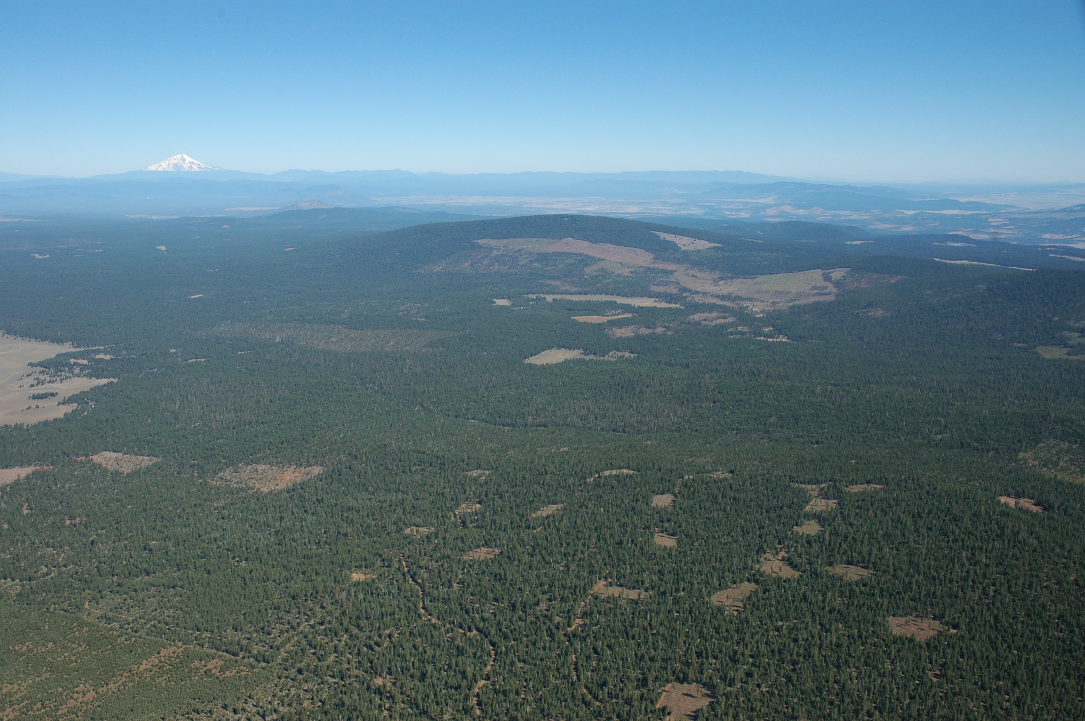
Carbon Sequestration and Fire Risk in a East-Side Pine Forest
Martin Ritchie
Research Forester
Pacific Southwest Research Station

Slide 2
Consider the relationship between goals of managing for carbon sequestration and minimizing risk of loss due to catastrophic fire

Slide 3
Location
Blacks Mountain Experimental Forest 10,400 ac
Aggressive fuels management program
Demonstration sites (437 acres)
Experimental plots (3,280 acres)
Operational fuels management (1,773 acres)
Untreated Control plots (513 acres)

Slide 4
Location
Blacks Mountain Experimental Forest
Aggressive fuel management program
Demonstration sites (437 acres)
Experimental plots (3,280 acres)
Operational fuels management (1,773 acres)
Untreated Control plots (513 acres)
Elevation range 5,400-6,900 feet, gentle slopes, <15%.
Precipitation ~20 inches annually about 2/3rd falls as snow Nov-March
Site index ~75-85 feet at base age 100.
Predominantly Ponderosa pine with some Jeffrey, White fir and cedar.

Slide 6
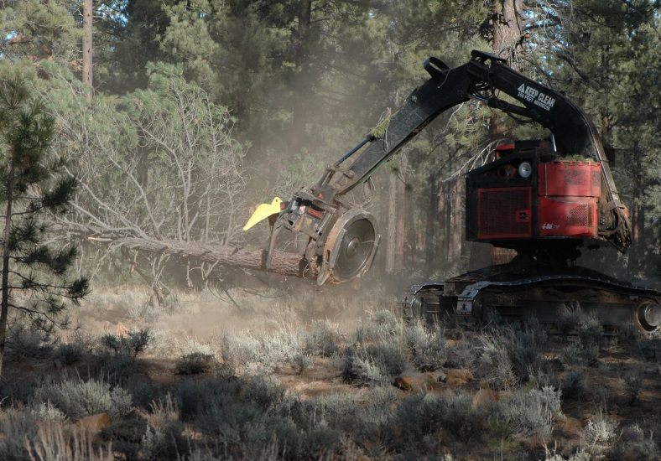
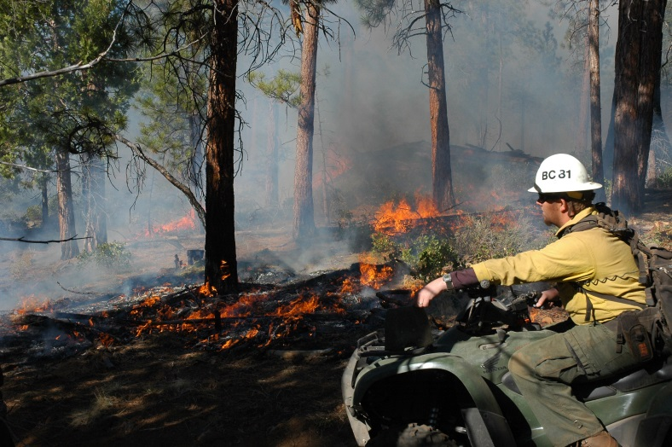
BMERP and RNA
High Diversity
Burned
Unburned
Low Diversity
Burned
Unburned
Untreated
Research natural area, unburned & no harvest.

Slide 7
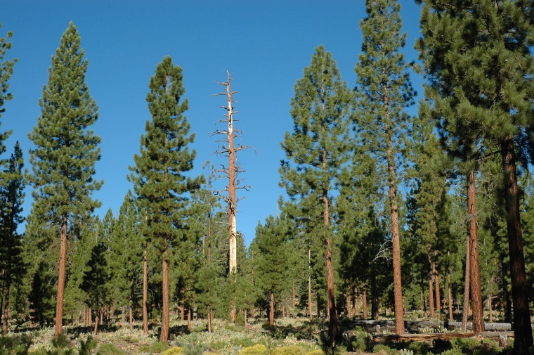
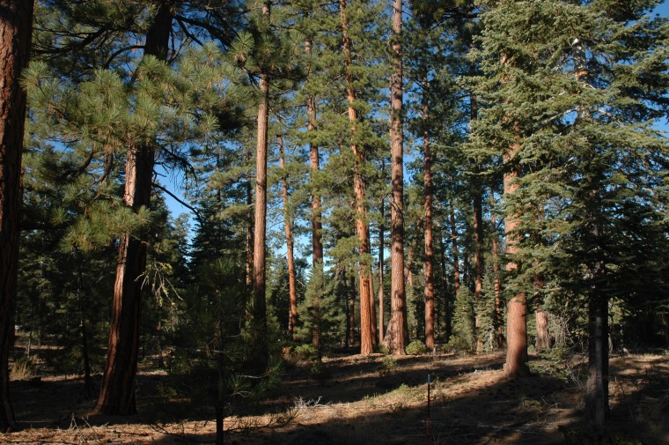
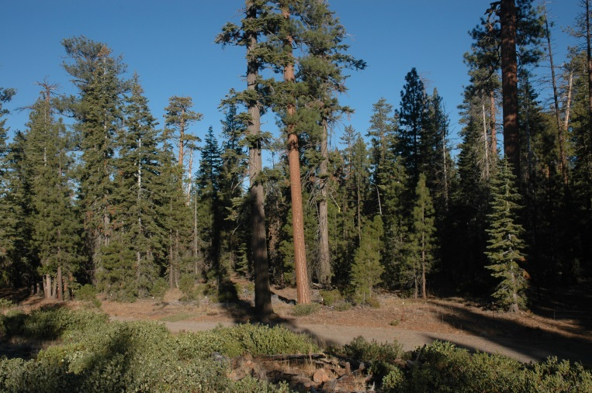
Stand Density
 | High Structural Diversity | Low Structural Diversity | RNA
Burned | 135 tpa, 100 ft² acre⁻¹ | 77 tpa, 38 ft² acre⁻¹
Unburned | 121 tpa, 103 ft² acre⁻¹ | 82 tpa, 39 ft² acre⁻¹ | 368 tpa, 140 ft² acre⁻¹
1-2
1
5
5
Thin
Burn
M
M
M
Study Timeline

Slide 8
Untreated: RNAD

Slide 9
What about fire and fuels??
3 metrics: Surface fuels, Standing live biomass and torching.

Slide 10
Surface Fuels 1000 hr Tons acre⁻¹
 | High Structural Diversity | Low Structural Diversity | RNA
Burned | 11 | 6
Unburned | 20 | 12 | 31
Untreated highest, followed by High Div. then Low Div.; Prescribed fire reduced surface fuels by about 50%
1-2
1
5
5
Thin
Burn
M
M
M
Study Timeline

Slide 11
Surface Fuels 1000 hr Tons acre⁻¹
 | High Structural Diversity | Low Structural Diversity | RNA
Burned | 11 | 6
Unburned | 20 | 12 | 31
Standing Live Tons acre⁻¹
 | High Structural Diversity | Low Structural Diversity | RNA
Burned | 52 | 19
Unburned | 55 | 17 | 70
Similar trend for effect of structure on standing live biomass, but relatively little effect of prescribed fire.

Slide 12
Surface Fuels 1000 hr Tons acre⁻¹
 | High Structural Diversity | Low Structural Diversity | RNA
Burned | 11 | 6
Unburned | 20 | 12 | 31
Standing Live Tons acre⁻¹
 | High Structural Diversity | Low Structural Diversity | RNA
Burned | 52 | 19
Unburned | 55 | 17 | 70
Probability of Torching (severe and moderate)
 | High Structural Diversity | Low Structural Diversity | RNA
Burned | 0.12 -- 0.01 | 0.26 – 0.02
Unburned | 0.96 -- 0.40 | 0.21 – 0.02 | 1.00 -- 0.88
Med.
Low
High

Slide 13
What about productivity (carbon)??
2 metrics
First: BF volume, Scribner.
Second: Above ground tree carbon, foliage excluded.

Slide 14
Net Growth BF* acre⁻¹year⁻¹
 | High Structural Diversity | Low Structural Diversity | RNA
Burned | -15 (s.e. = 48) | 55 (s.e. = 5)
Unburned | 90 (s.e. = 27) | 78 (s.e. = 9) | -71 (s.e. = 129)
1-2
1
5
5
Burn
M
M
M
*Scribner 32 foot logs, 6 inch top

Slide 15
Above-ground Carbon Sequestration (Trees)
Zhang, Ritchie, Maguire & Oliver 2013
Crawford Creek 5 year PAI GSL 30 @Age 98
1.4 Mg C ha⁻¹ year⁻¹ Biomass → 0.7 in C
Lookout Mountain 5 year PAI GSL 30 @Age 100
1.6 Mg C ha⁻¹ year⁻¹ Biomass → 0.8 in C
At Blacks Mountain :
20 treated stands: Mean=0.50 Mg C ha⁻¹ year⁻¹; Range -0.67 to 1.1

Slide 16
Net Growth BF* acre⁻¹year⁻¹
 | High Structural Diversity | Low Structural Diversity | RNA
Burned | -15 (s.e. = 48) | 55 (s.e. = 5)
Unburned | 90 (s.e. = 27) | 78 (s.e. = 9) | -71 (s.e. = 129)
Tree Carbon (Mg C ha⁻¹ year⁻¹ )
 | High Structural Diversity | Low Structural Diversity | RNA
Burned | 0.04 (s.e. = 0.35) | 0.44 (s.e. = 0.19)
Unburned | 0.76 (s.e. = 0.23) | 0.79 (s.e. = 0.21) | -0.29 (s.e.=1.22)
*Scribner 32 foot logs, 6 inch top

Slide 17
Net Growth BF* acre⁻¹year⁻¹
 | High Structural Diversity | Low Structural Diversity | RNA
Burned | -15 (s.e. = 48) | 55 (s.e. = 5)
Unburned | 90 (s.e. = 27) | 78 (s.e. = 9) | -71 (s.e. = 129)
Tree Carbon (Mg C ha⁻¹ year⁻¹ )
 | High Structural Diversity | Low Structural Diversity | RNA
Burned | 0.04 (s.e. = 0.35) | 0.44 (s.e. = 0.19)
Unburned | 0.76 (s.e. = 0.23) | 0.79 (s.e. = 0.21) | -0.29 (s.e.=1.22)
Carbon P-values
 | High Structural Diversity | Low Structural Diversity | RNA
Burned | 0.913 | 0.081
Unburned | 0.021 | 0.019 | 0.856

Slide 18
So What?
Across a range of conditions related to fire behavior, productivity varied substantially.
In these east side pine stands our treated units averaged about 0.5 Mg ha⁻¹ year⁻¹ ; twenty were positive and two were negative (both were burned high diversity plots).
Untreated stand mortality was high and net C seq. was not different from zero, maybe negative even.
Prescribed fire reduced net Carbon sequestration in trees (short term ~10 years)
Both thinning treatments (without Rxfire) produced net C sequestration ~0.75.
High structural diversity stands were also highly variable; i.e. productivity is highly unstable due to mortality, but among unburned treatments, no difference in C; negligible difference in Bfvol.

Slide 19
Questions?
 | High Structural Diversity | Low Structural Diversity | RNA
Burned | 135 tpa, 100 ft² acre⁻¹ | 77 tpa, 38 ft² acre⁻¹
Unburned | 121 tpa, 103 ft² acre⁻¹ | 82 tpa, 39 ft² acre⁻¹ | 368 tpa, 140 ft² acre⁻¹

