Slide 1
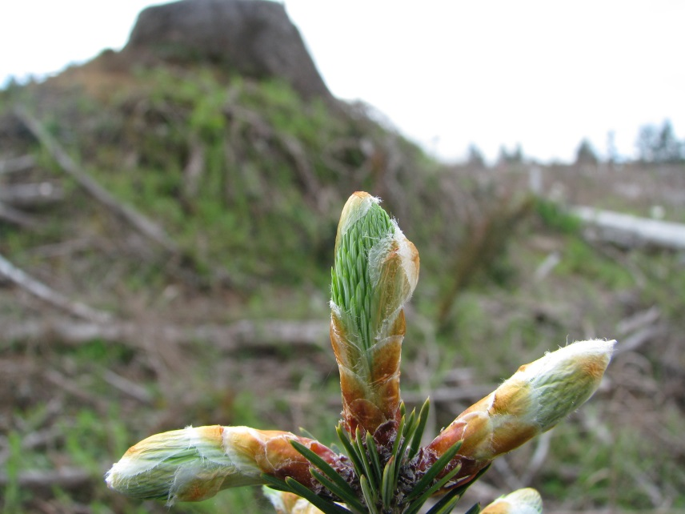
Will changes in phenology track climate change?
A study of height- and diameter-growth initiation timing in coast Douglas-fir
Kevin R. Ford, Constance A. Harrington, Sheel Bansal, Peter J. Gould, J. Bradley St.Clair
USDA Forest Service, Pacific Northwest Research Station Washington Department of Natural Resources

Slide 2
When should a tree start growing in the spring?

Slide 3
When should a tree start growing in the spring?

Slide 4
When should a tree start growing in the spring?

Slide 5
When should a tree start growing in the spring?

Slide 6
When should a tree start growing in the spring?

Slide 7
When should a tree start growing in the spring?

Slide 8
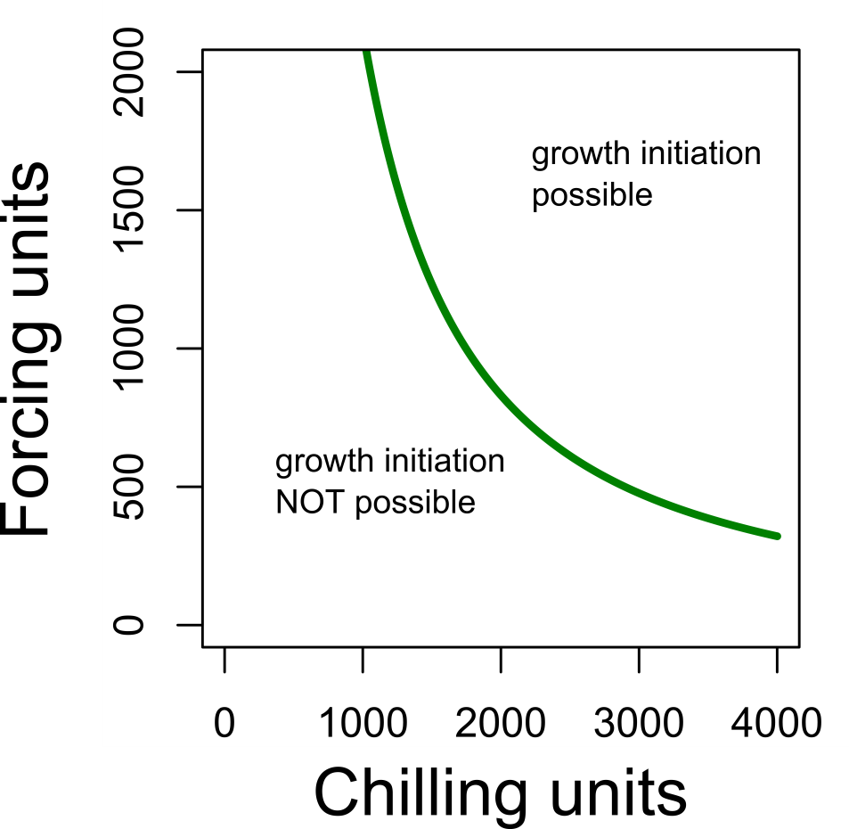
What determines when a tree starts growing in the spring
Exposure to warm temperatures (“forcing”)
Amount of forcing required depends on exposure to cool temperatures (“chilling”)
The “possibility line”
Well understood for budburst, but not other phenological events

Slide 9
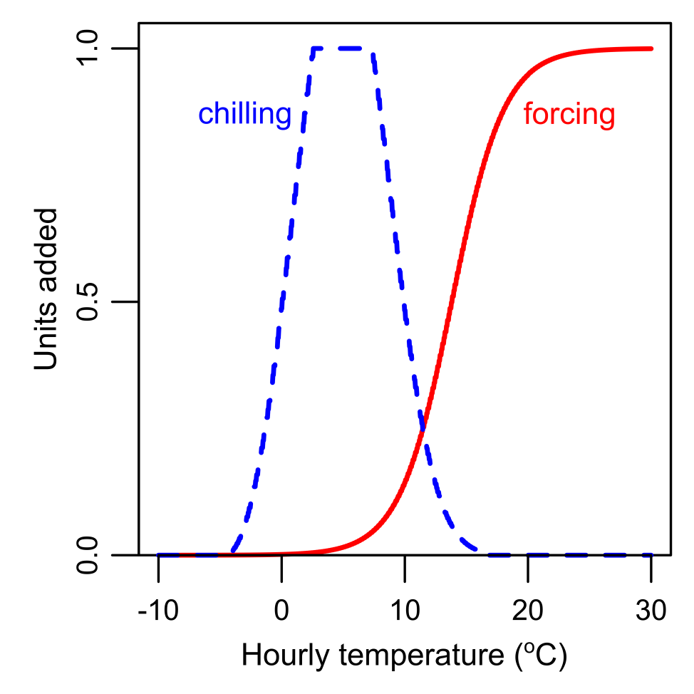
Chilling and forcing functions

Slide 10
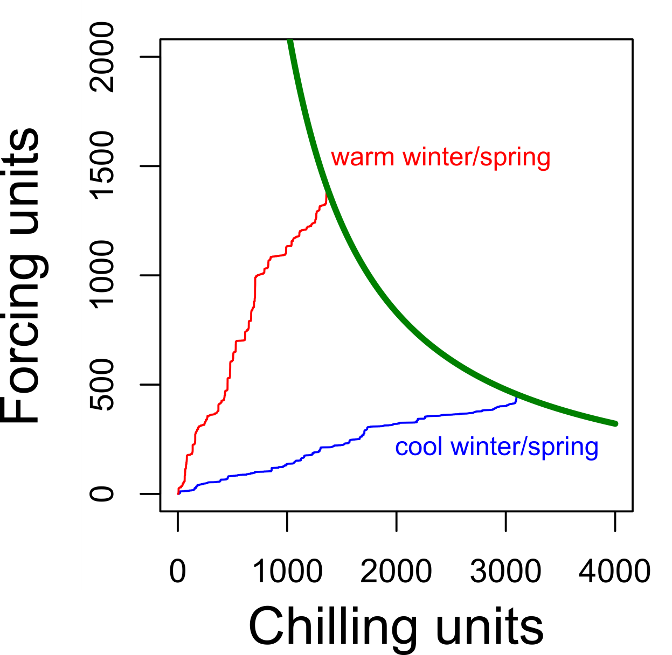
How chilling/forcing can affect growth initiation timing

Slide 11
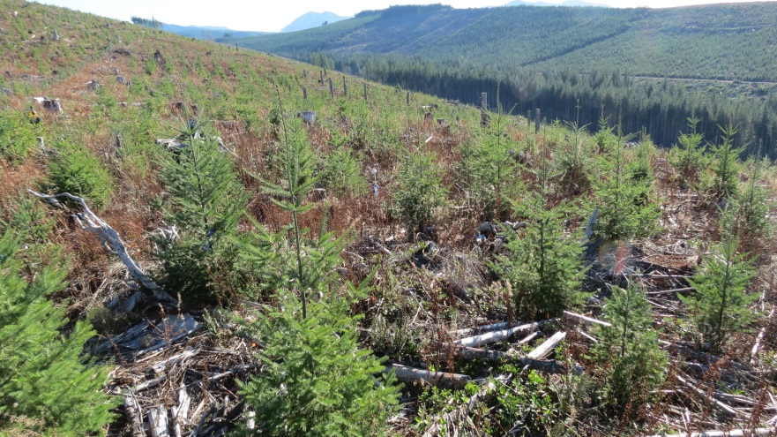
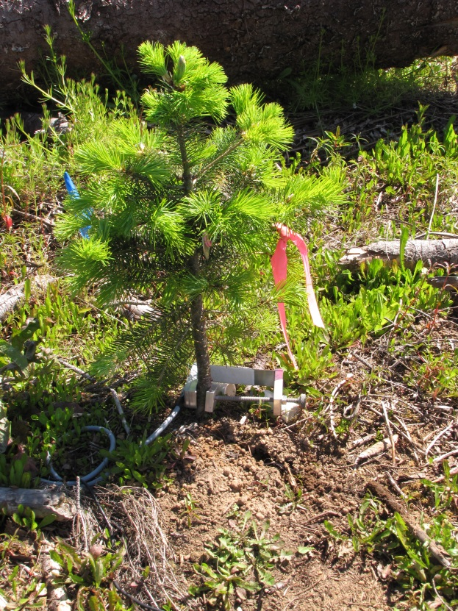
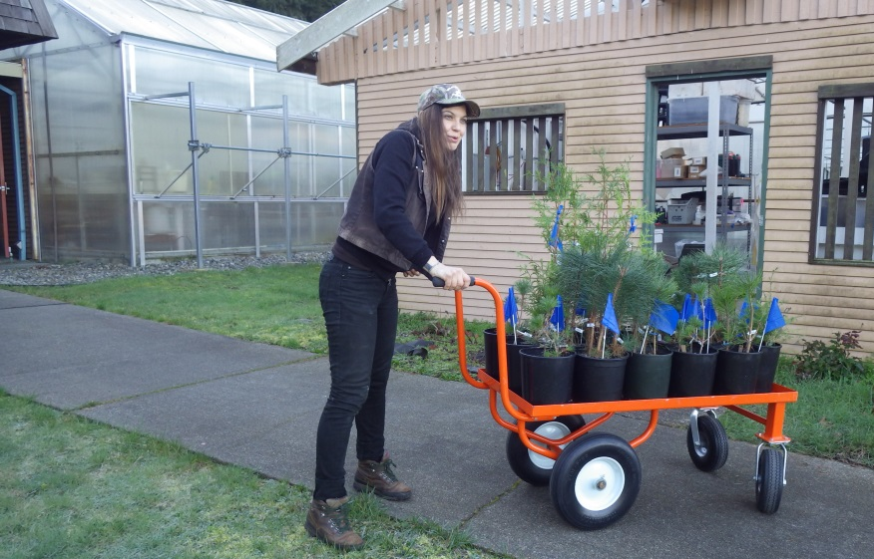
Methods
height-growth initiation
field site
field sites
controlled
environments
seed sources
controlled environment
diameter-growth initiation

Slide 12
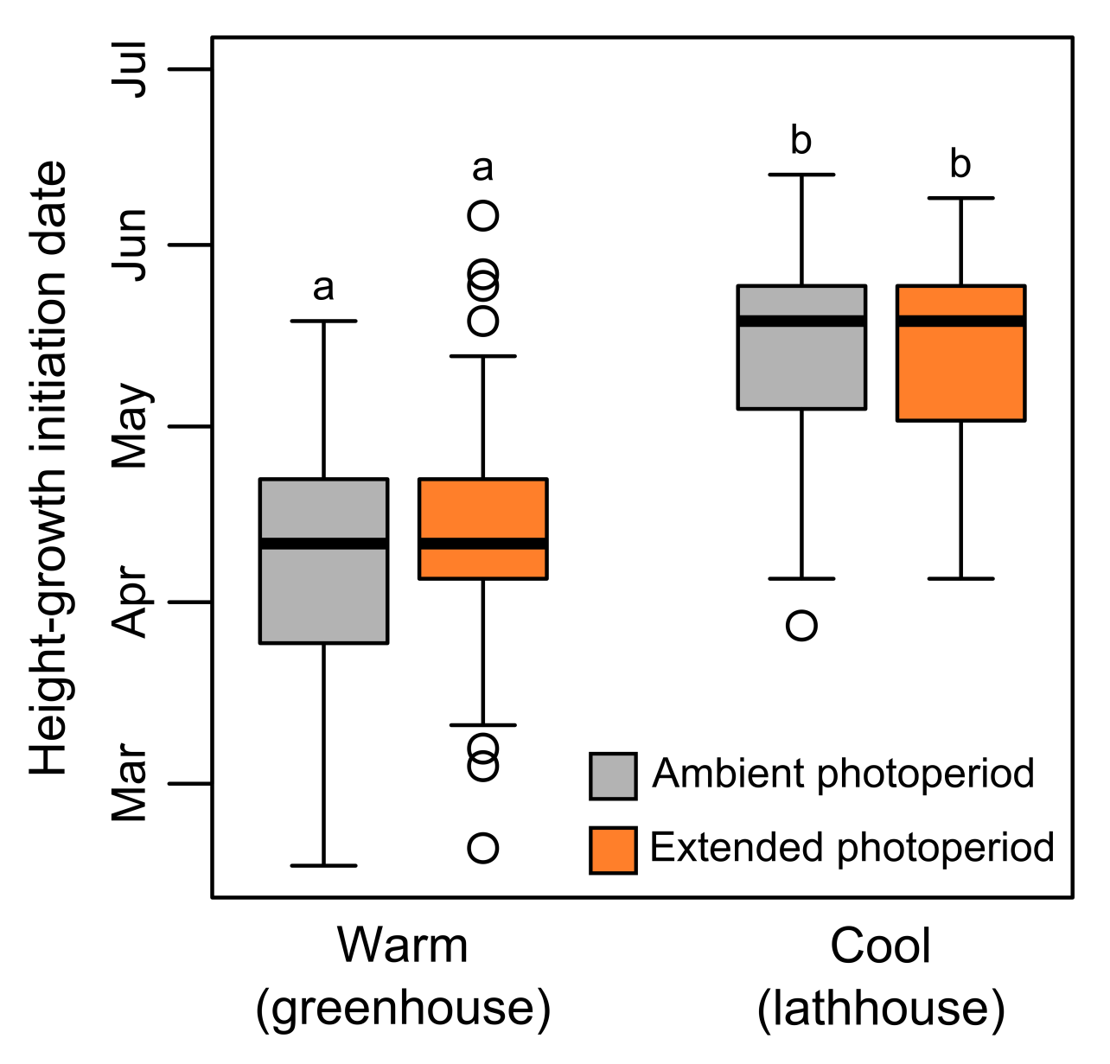
No evidence for photoperiod effect
Also see Laube et al., 2014, Global Change Biology

Slide 13
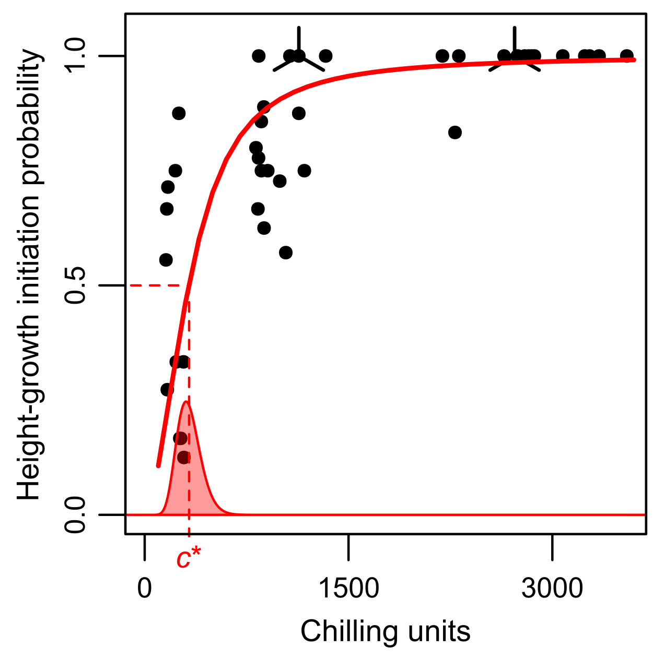
Probability of growth initiation
All had successful diameter-growth initiation
$$p=\frac{C^{b}}{{c^{∗}}^{b}+C^{b}}$$
Minimum chilling requirement for height but not diameter growth
Notes:
c* = 327

Slide 14
Possibility lines
$$F=e^{a−blog(C)}$$

Slide 15
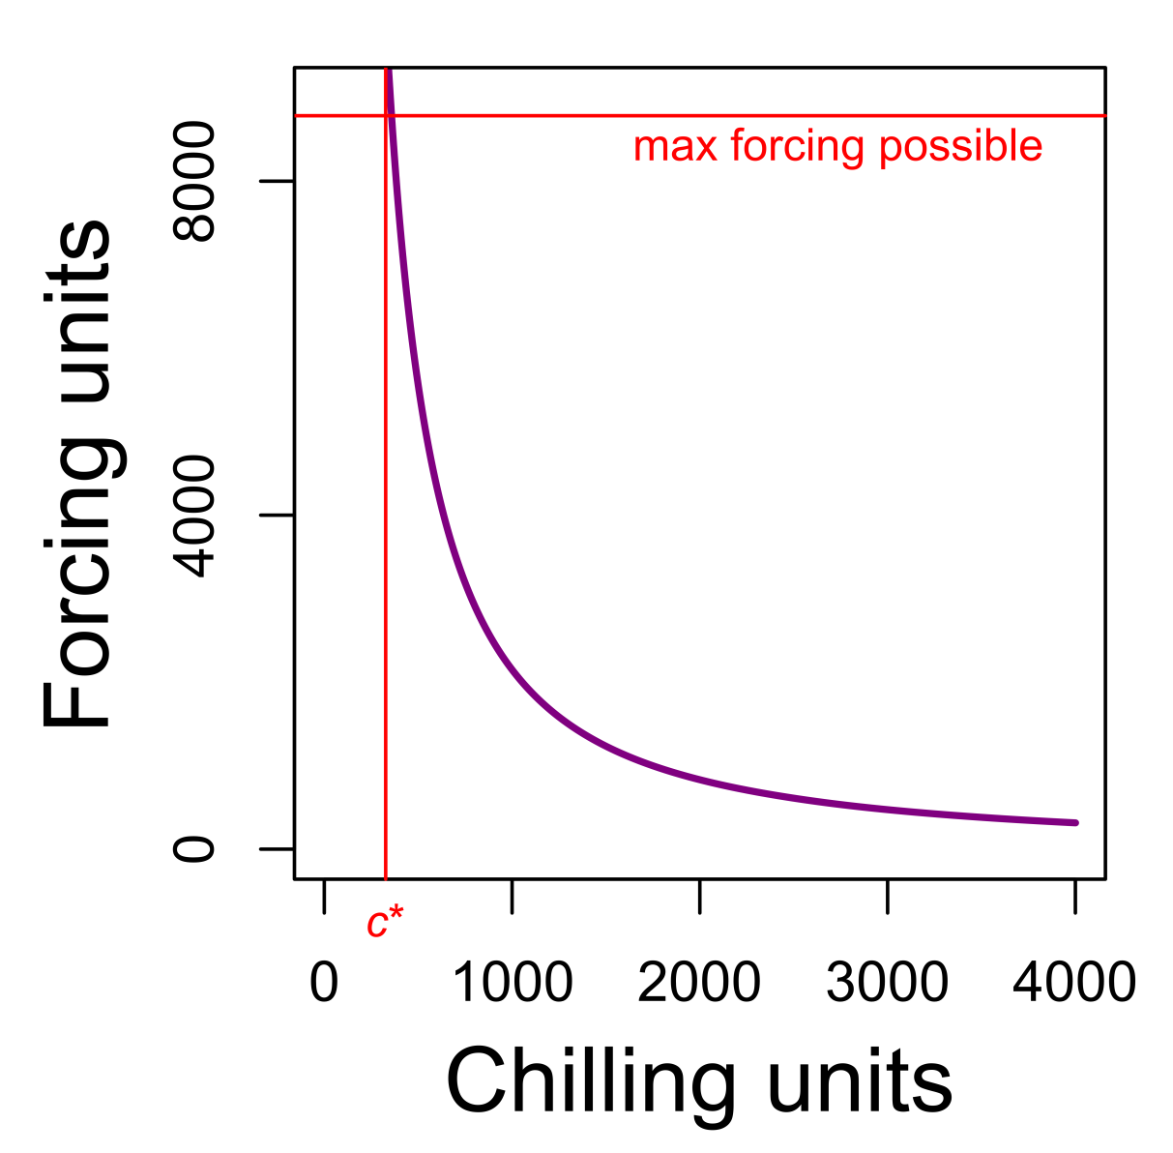
Possibility line and minimum chilling requirement for height-growth initiation
Notes:
Purple curve shows the possibility line fit to terminal budburst data (chilling and forcing at time of 50% budburst) with log-log-linear model. c* is the parameter from the terminal budburst probability model that defines the chilling value at which the probability of budburst is 50%. The max forcing possible value is the maximum number of forcing units that can be accumulated in a year (i.e., number of hours in a [leap] year = 366*24 = 8784). These two things were developed with the same data but completely separate models. I think it shows that our modeling matches well with biological theory given the data.

Slide 16
Possibility lines

Slide 17
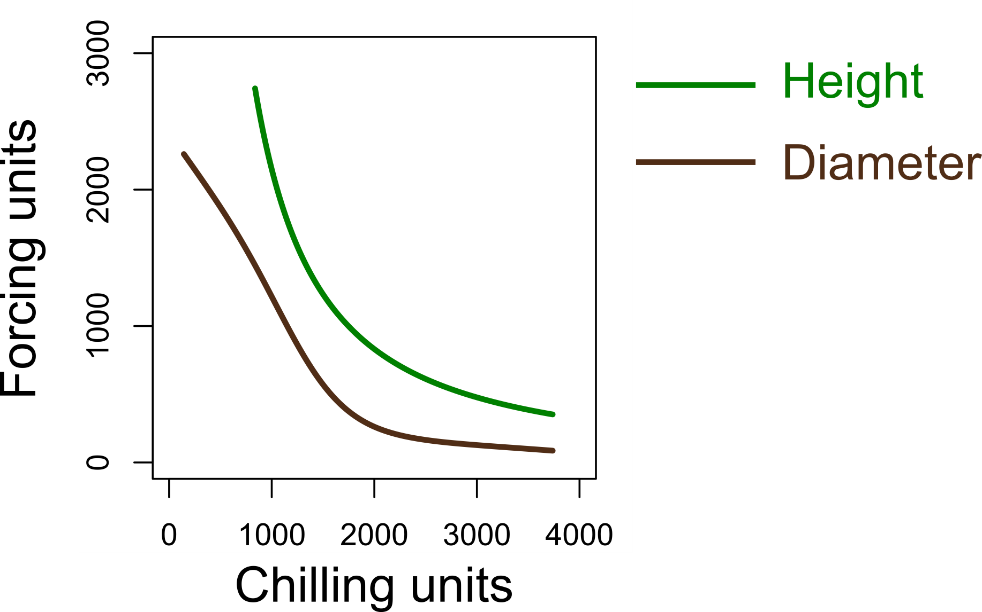
Possibility lines comparison

Slide 18
Height-growth initiation timing

Slide 19
Diameter-growth initiation timing

Slide 20
Growth initiation date changes
Height
Diameter
Change in days

Slide 21
Frost risk following growth initiation
Height
Diameter
Change in hours < -2°C

Slide 22
Quantifying climatic favorability
Plants need energy AND moisture for growth
Measure of favorability should account for the simultaneous availability of energy and soil moisture

Slide 23
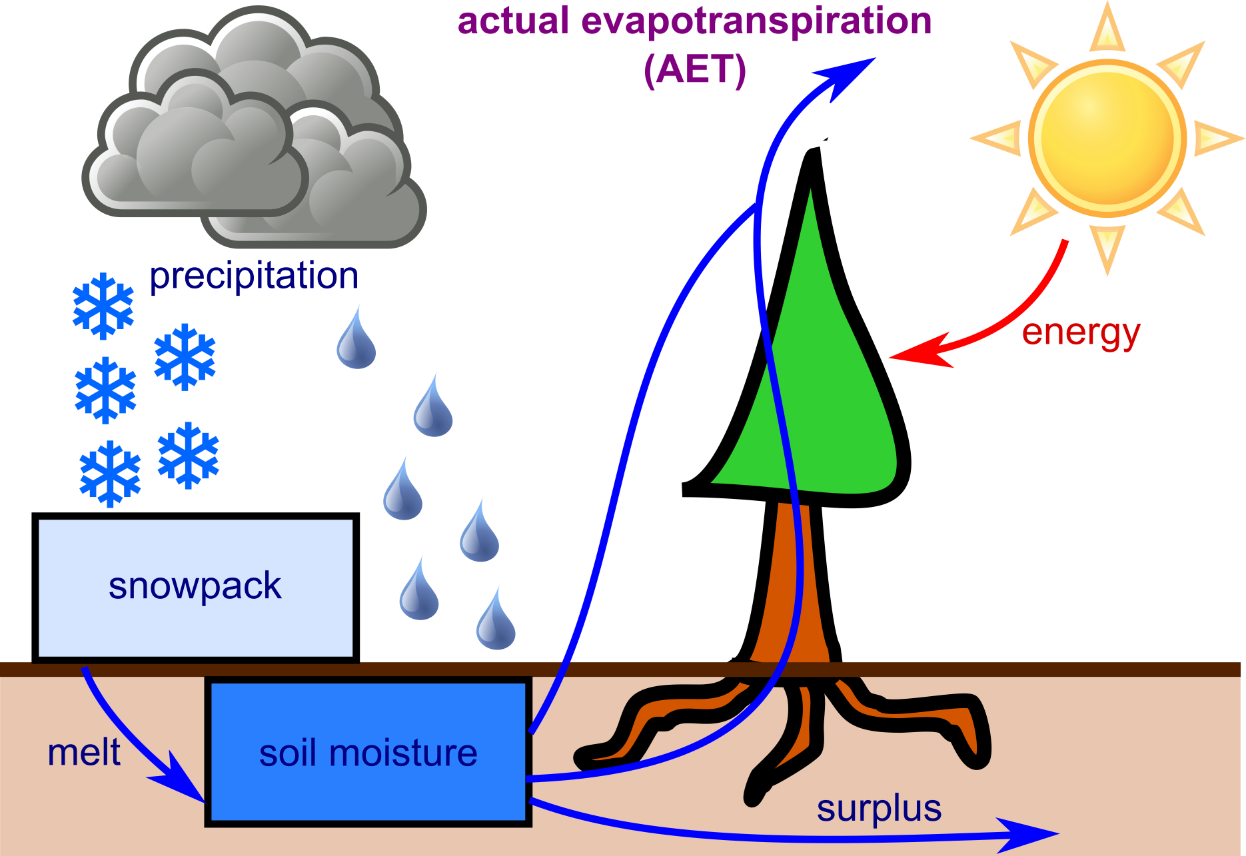
Actual evapotranspiration (AET) as a measure of climatic favorability

Slide 24
AET across Douglas-fir range in region

Slide 25
Favorable growing conditions
Change in proportion of favorable conditions (AET) captured:

Slide 26
Diameter
Change in date
Change in proportion of favorable conditions (AET) captured

Slide 27
Conclusions
Growth initiation could lag changes in favorable conditions near low latitude/elevation range limits
Risk of increased frost exposure is possible, especially at high elevations, but seems relatively minor and rare
Height- and diameter-growth initiation follow broadly similar patterns, though diameter growth seems to lag behind climate change more

Slide 28
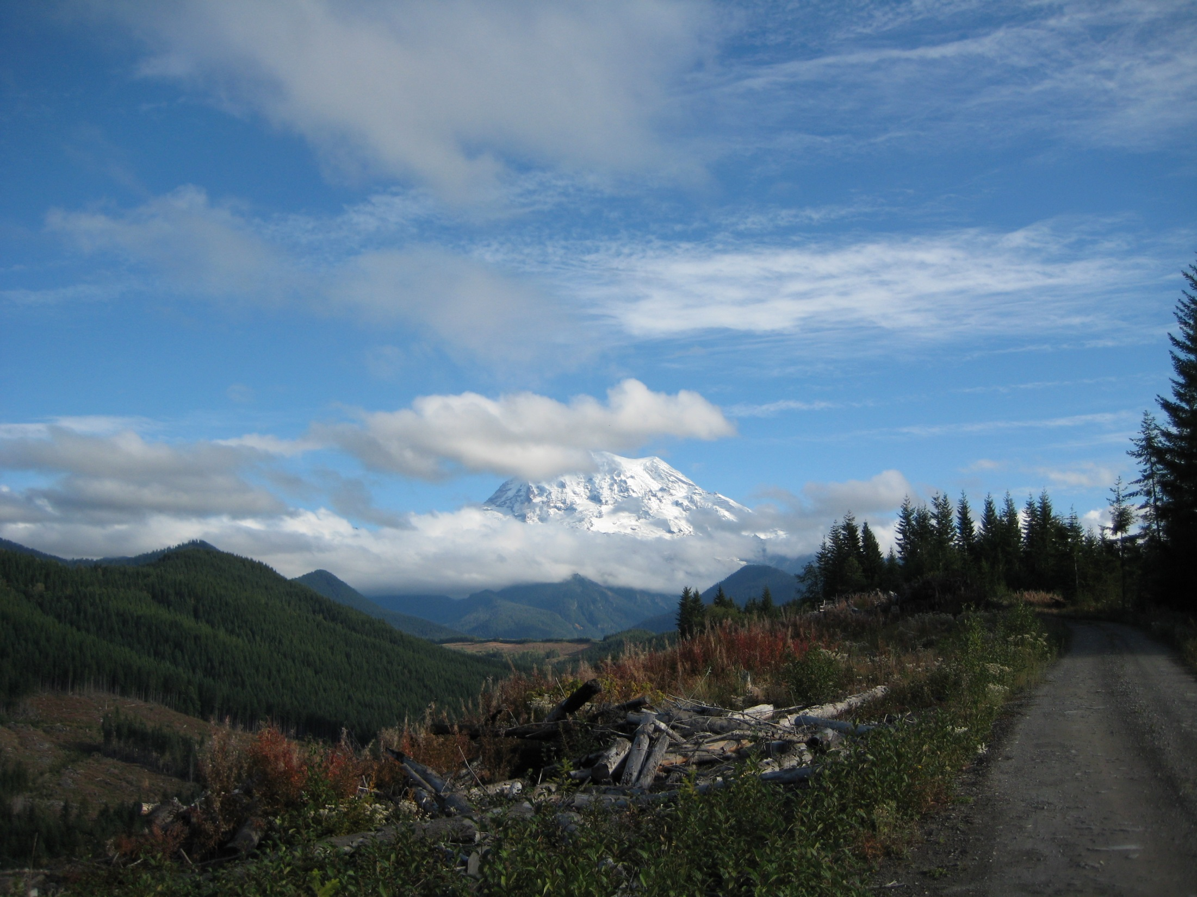
Acknowledgements
Funding
Bureau of Land Management
USDA Forest Service PNW Research Station
Land owners
Cascade Timber Consulting
Giustina Land and Timber
Hancock Forest Resources
Lone Rock Timber Company
Port Blakely Tree Farms
Roseburg Resources
Starker Forests
USFS Stone Nursery
WA DNR

Slide 30
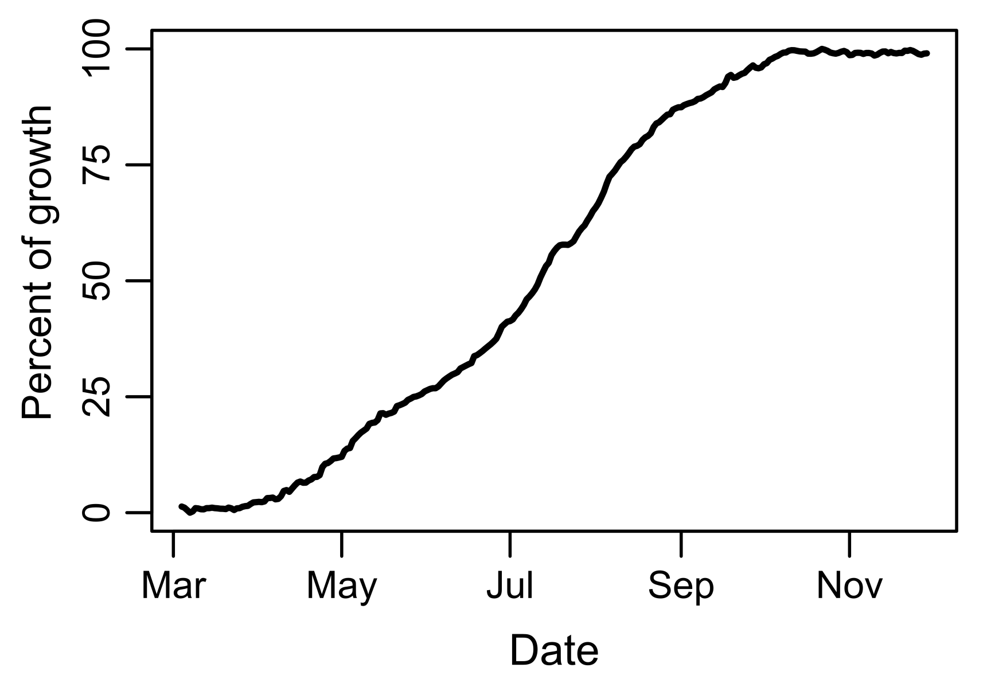
Patterns in seasonal growth progression

Slide 31
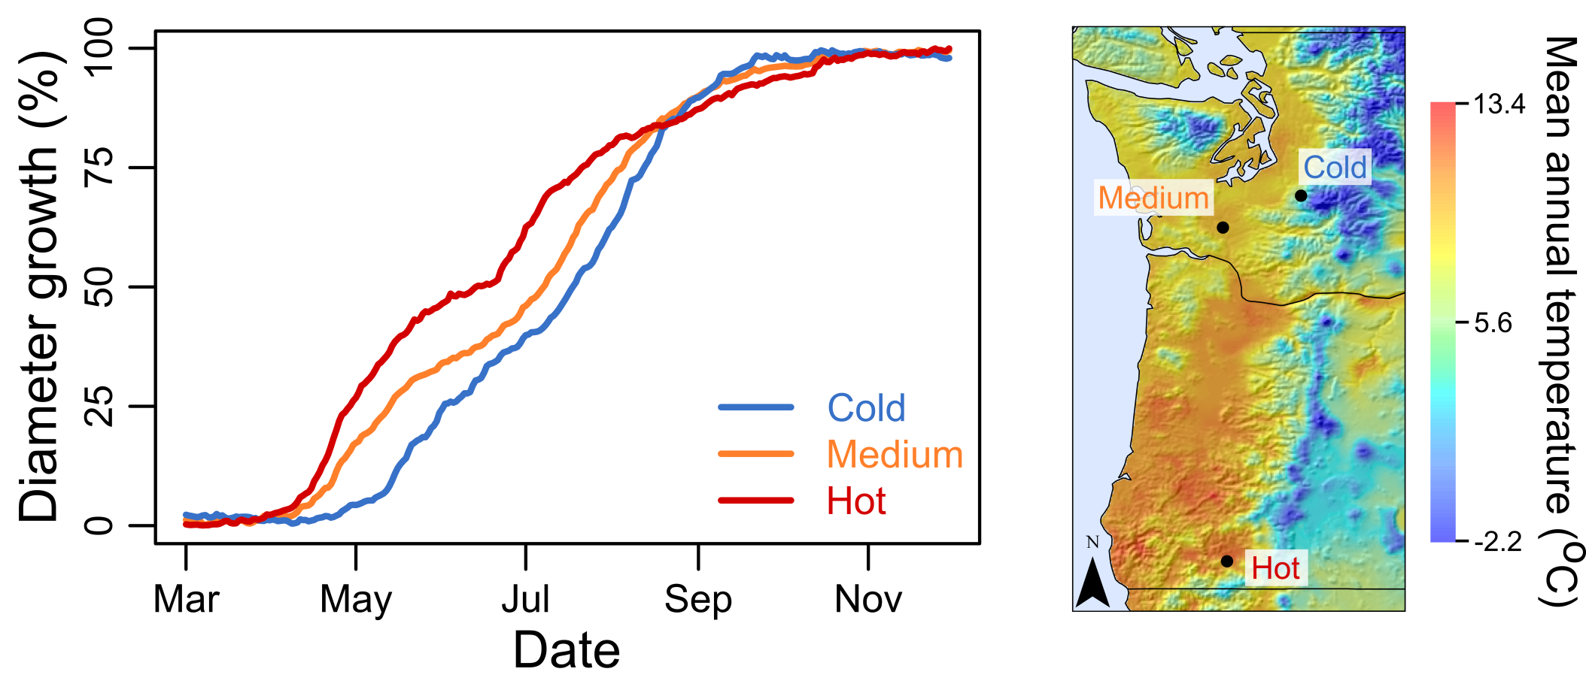
Growth progression varies by location
Notes:
Diameter growth by site for DF. Top graph shows data for WACST at each of the sites in 2012

Slide 32
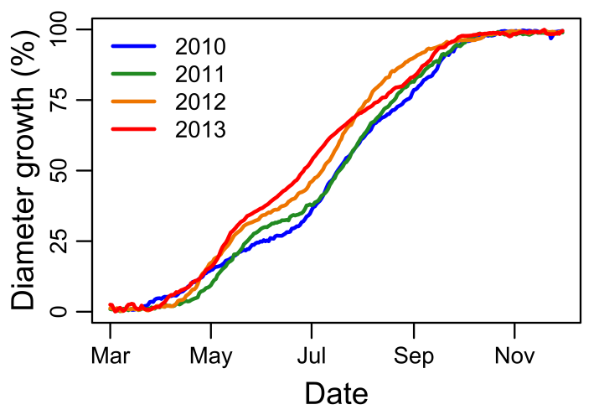
Growth progression varies over time
Notes:
Diameter growth by year for DF. Buckhorn, WACST.

Slide 33
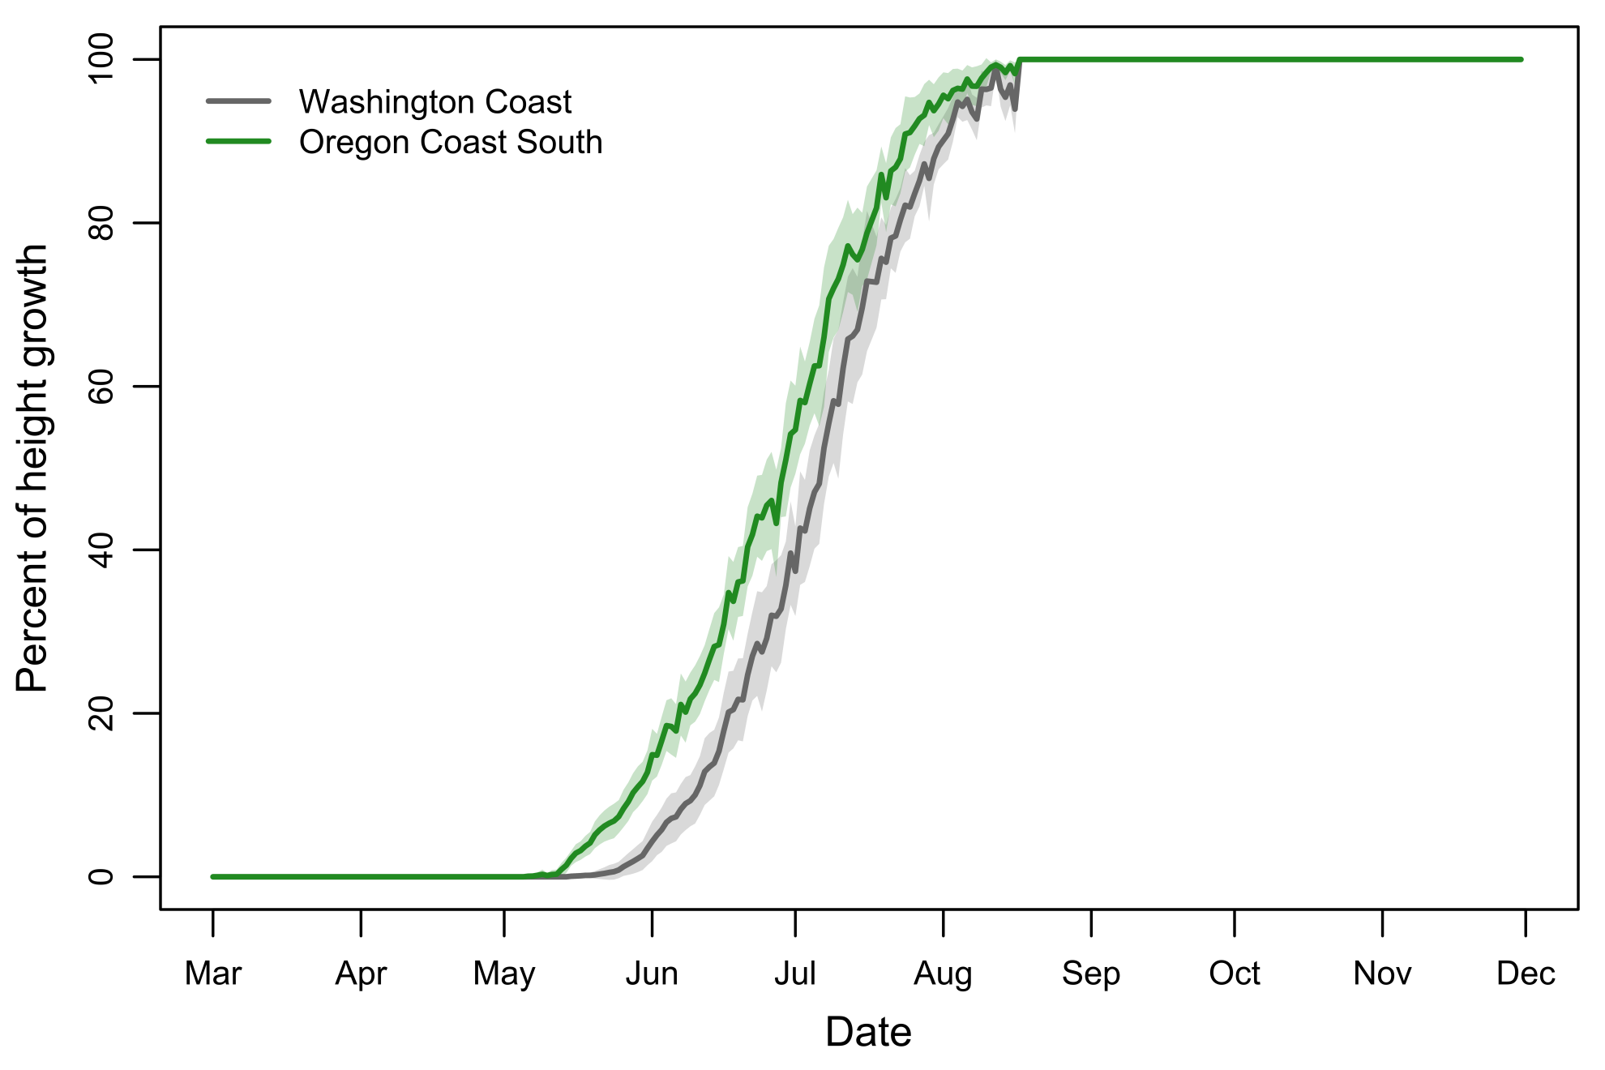
Growth phenology varies by seed source
Notes:
Doug-fir, Buckhorn, 2012, shading shows 95% confidence interval

Slide 34
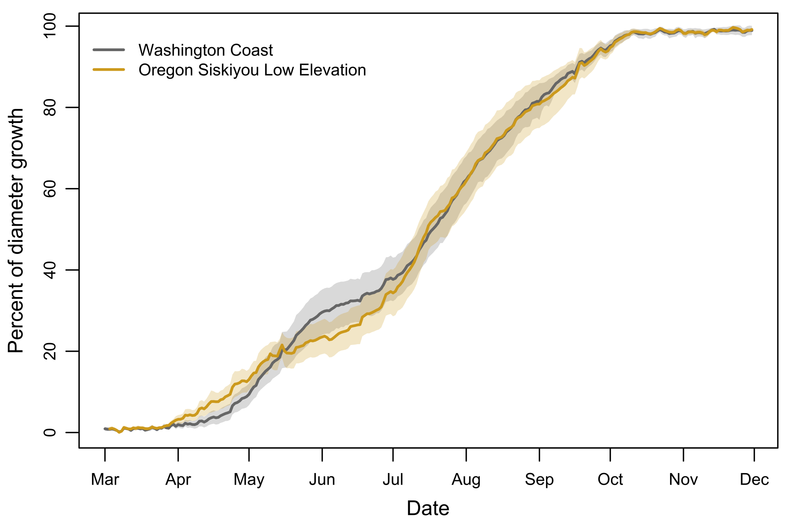
Growth phenology varies by seed source
Notes:
Doug-fir, Buckhorn, 2011, shading shows 95% confidence interval

Slide 35
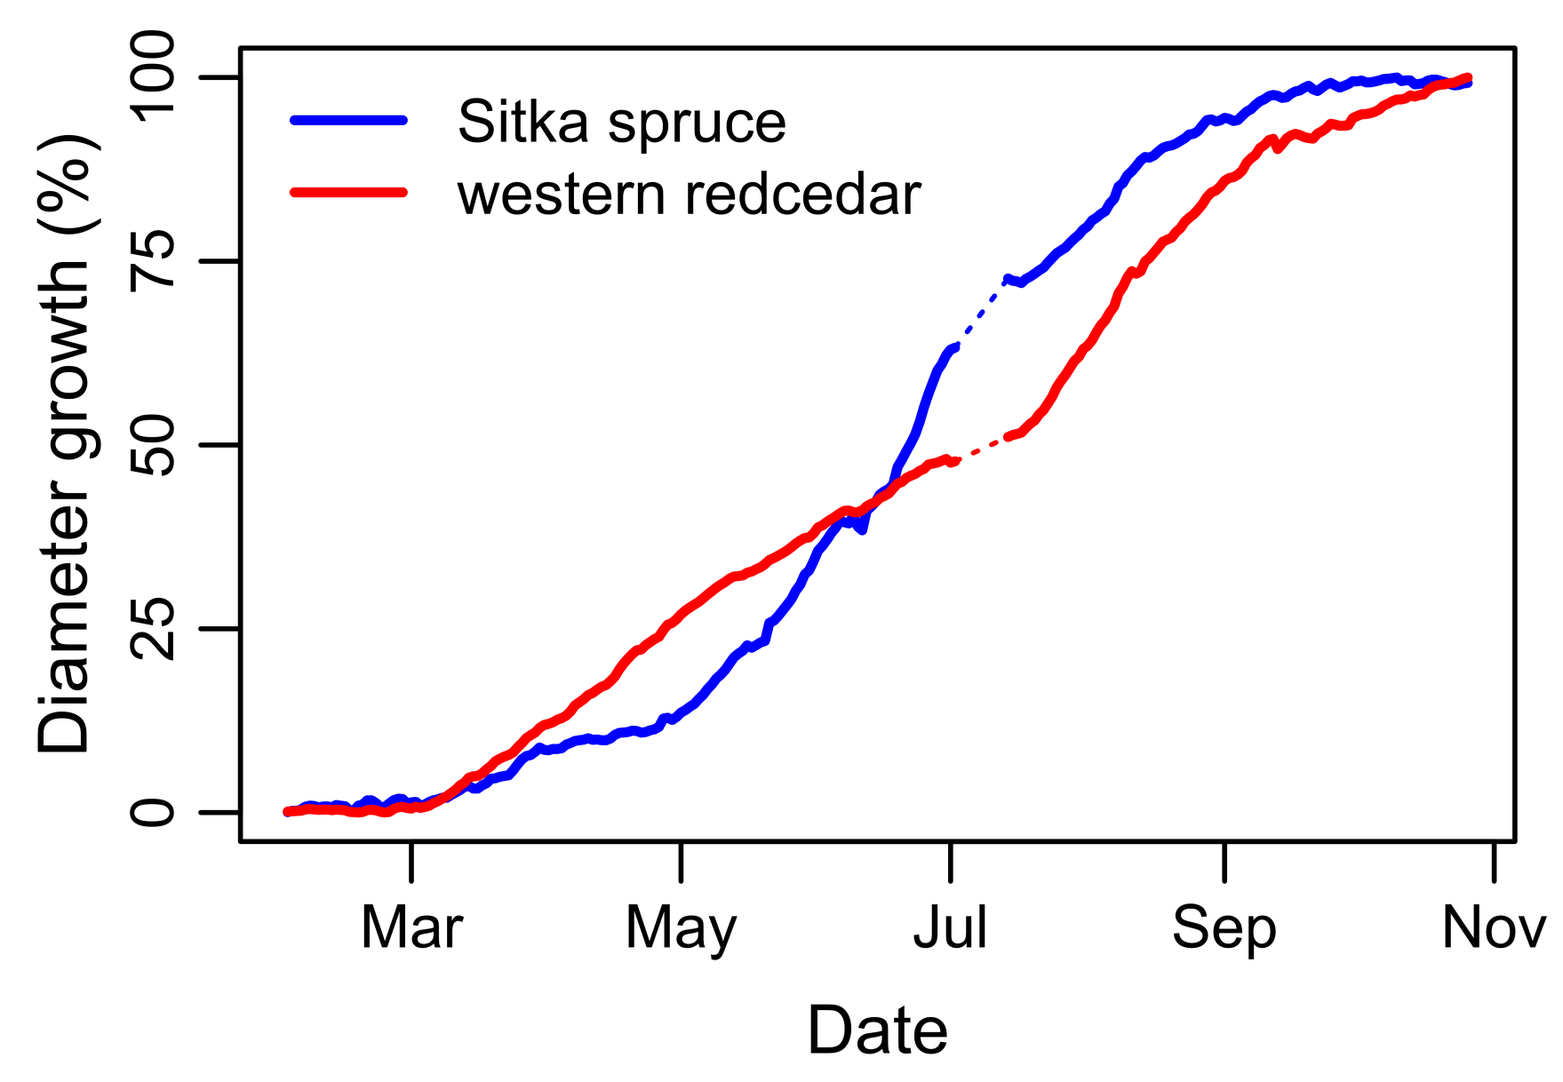
Growth phenology varies by species

Slide 36
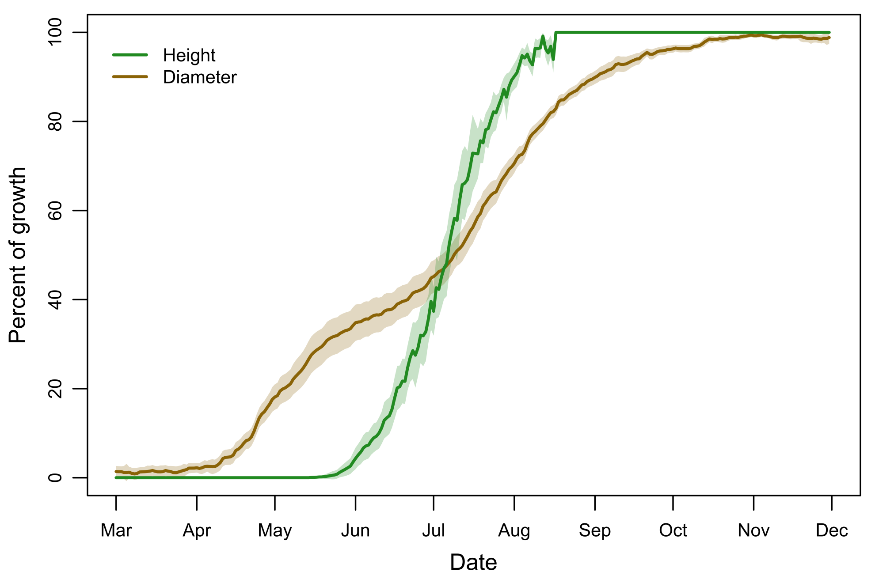
Height and diameter growth interact (?)
Notes:
Doug-fir, WACST, Buckhorn, 2012, shading shows 95% confidence interval.

Slide 37
End

Slide 38
Model fit
The r² values for comparisons between predicted and observed values for the growth initiation models.
Explanatory variables used to make predictions | Probability of height-growth initiation | Forcing required for height-growth initiation | Forcing required for diameter-growth initiation
Chilling only | 0.563 | 0.795 | 0.974
Chilling plus genetic random effect | 0.715 | 0.805 | 0.975

Slide 39
Height
Change in days
Change in proportion of favorable conditions (AET) captured

Slide 40
Diameter
Change in days
Change in proportion of favorable conditions (AET) captured

Slide 41
Frost risk
Change in hours < -2°C

Slide 42
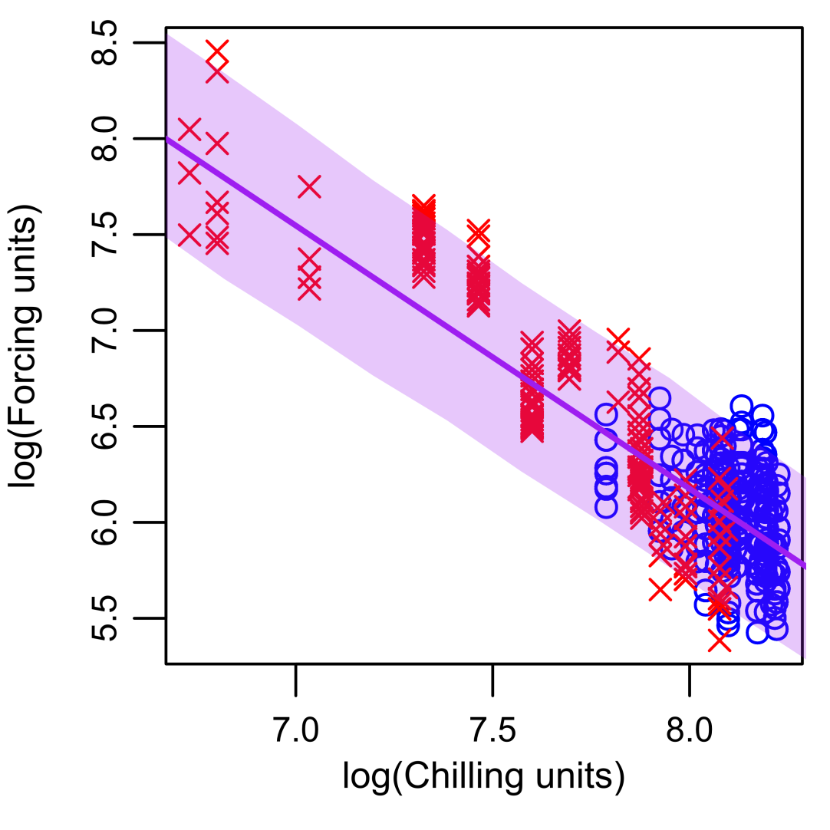
Possibility lines
$$\log\left(F\right)=a−blog(C)$$
$$\log\left(F\right)=a−blog(C)$$
$$F=e^{a−blog(C)}$$

Slide 43
Possibility lines

